Slide 1
Early Literacy and Teen Services
SCLS Board Presentation
October 10, 2011

Slide 2
Early Literacy Statistics
Babies are born with the potential to learn the sounds and concepts of any language
Socioeconomic status and early literacy
It’s necessary to have reading materials in the home
Kindergarten readiness:
  Middle-income- 20,000-30,000 words
  Lower-income -5,000 words
Modeling literacy activities
Notes:
They lose this potential as the language they are learning shape the way they think and hear. This is completely natural/necessary (weeding of synapses) and research shows that 9 – 10 months is a critical stage in language acquisition (or the ability to learn language/that words have meaning). If children haven’t been actively engaged w/language, words, songs, etc. at this age their brains haven’t been given the input they need to learn language – ANY language. So it’s important to talk, read, sing, engage with very young babies -- it is important that parents read to their children in their native language. (Nature, July 22, 2004. pp. 453.) We all know that babies brains need stimulation to grow.
The Socio economic status of the family that a child is born into plays a role in his/her language and literacy development
61% of families living in poverty have no books or reading materials whatsoever in their homes (U.S. Department of Education study) and 68% of all welfare recipients have minimal literacy skills.
Studies show that children from middle-income families begin kindergarten with a vocabulary of between 20,000-30,000 words; children from lower-income families start school with about 5,000 words
But the amount of $$ a family has – or doesn’t have – is not a cut & dried definition of future educational success. Being born into poverty does NOT mean that a child will have lower literacy skills.
Another national study (National Center for Educational Statistics) shows that regardless of poverty status, children who are exposed to books display higher levels of reading knowledge than children who have very little or no exposure to literacy activities. This means that poor children and parents who have access to free library books and programs during the early years will develop early literacy skills at the same rate as children who live in middle income families – if you have books in the home you are better prepared for school. Public libraries get the books into the hands of ALL children and their families. And trained youth services librarians model ways that parents & caregivers can interact with their children and books at home. Early literacy programs at public libraries are for parents and caregivers, too.

Slide 3
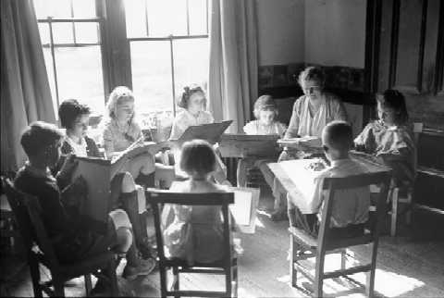
Radical shift
Library story hour, early 20th century
Where are the parents?
Notes:
This idea of engaging adults at a program for young children is a completely opposite model of the old fashioned library storytime or storyHOUR– little children go into a closed room all by themselves for a library program & parents wait for them.
Our goal is to get parents engaged in the storytime so that they go home with the necessary tools to continue your good work after story time

Slide 4
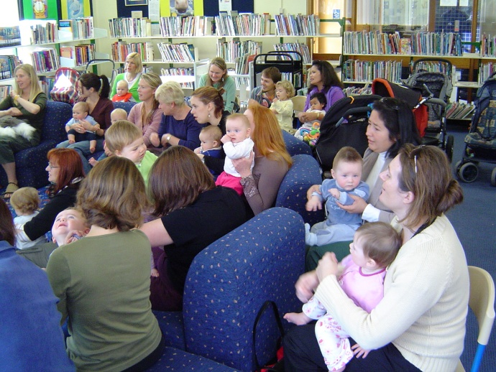
Radical shift
Lapsit story program, 21st century
Babies and parents!
Notes:
And – as a side benefit – this actually helps stop parents from having their own coffee klatch in the back of the room. If they are involved in the program – and expected to participate – they are less likely to have whispered conversations!
The youth services librarians and I have spent a lot of time identifying ways to introduce information about early literacy & literacy activities to parents during our programs for very young children. The ways that we introduce this information can be done in different ways - ways that feel the most comfortable for librarians and ways that address the different learning methods of the parents who bring children to your programs

Slide 5
2007 Survey results
(Dane Co. UW-Extension)
Enjoyment of children’s books 90.5%
Activities that relate to books 87.3%
Socialization for children 85.7%
Fun! 85.7%
We like the children’s librarian 79.3%
Gets us to the library 76.2%
Gets us ready for group time at school 61.9%
Socialization for me! 34.9%
Good experience for different aged kids 26.9%
(Participants were allowed to check all that apply)
Notes:
But why should we change our methods and begin talking directly to parents?
Joan Laurion conducted a survey to determine what parents value about library programs. One of the questions that she asked, “Why do you come to library story time” resulted in some interesting responses.
This tells us:
That parents value books and reading (nos. 1 &2).
And it also tells us that storytime is fun and that they look forward to coming week after week.
But I’m particularly pleased-impressed-overjoyed that nearly 80% of the parents responded that they like their youth services librarian who shares stories with their children.

Slide 6
They like us!
Parents value the services we provide
Parents trust us
Parents are a kind, accepting audience
Notes:
But I’m particularly pleased-impressed-overjoyed that nearly 80% of the parents responded that they like their youth services librarian who shares stories with their children.
They value the services we provide.
Let’s translate this liking to trust – and when parents trust us they will take what we have to say about books, reading and building literacy skills to heart. They value what you have to say and the services that you provide.
This also means that they are a kind audience and will be patient when we introduce new concepts and ideas in the programs that they love.
An extremely interesting comment was:
I’m learning English, so it’s a good time for practice. Thanks!
This comment is an example of the adult learning that takes place in storytime – it shows that adults are willing to look at this as a time for them to learn, too.

Slide 7
Sending the message home
Be cognizant of learning styles
Visual – Images and seeing
Auditory - Words and listening
Kinesthetic – Movement and doing
Notes:
40% of learners are visual learners
10% are auditory
50% are kinesthetic
But 80% of instructional delivery is auditory – it’s the traditional lecture and listen model (kind of like my presentation!)
The environment also affects the way people learn. While we might be most comfortable in a quiet, classroom style room as teachers/facilitators, some people prefer a lot of activity and stimulation. Learning can take place in the chaos of a story time!
In the past several years we’ve looked at ways that librarians make sure that they are including activities in their programs that include different learning styles –
Visual learners – recognize that parents & children learn by watching you; A simple word like “remember” helps job visual learners memories and helps them connect to a previous experience – it helps them visualize the experience; they like handouts to take home and look at later.
Auditory learners – say it!; Use phrases like “this is important to your child’s development” and they will remember; Auditory learners appreciate are linear and structure oriented, so librarians maintain structure from one week to the next; Auditory learners rely on words and language. A handout that reminds them of the important things you said during your program.
Kinesthetic learners - Let them do it – ask parents to join their kids in a fingerplay, song, activity or say a repeated phrase; Some lap sit programs have multiple copies of board books and instead of watching the librarian, parents read directly to their children; And after kinesthetic learners have sat through all the visual and auditory stimulation of a story time, give them a chance to connect to their children by providing space for parents to read & play after the program.
These are the learning styles that most people are familiar with – some of you might have heard of additional styles such as musical/rhythmic, interpersonal, intrapersonal, logical/mathmatical as described by David Lazear in his book Seven Ways of Knowing. Let’s face it – there are many different ways that we take in the world.

Slide 8
Serving Teens
It’s a large – and growing – population!
25 – 30% of all public library users are between the ages of 12 – 18
Public libraries as gathering place for all teens
Developmental Assets for Teens (Search Institute, MN)
  Support
  Empowerment
  Boundaries & Expectations
  Constructive Use of Time
Notes:
Based on recent state and national population statistics, the adolescent population is a growing one – there are more teenagers now than in previous generations. Middle schools, high schools and higher educational institutions are scrambling to deal with the needs of this growing population and, for many teens, their educational experiences are simply adequate.
As a community concerned about our shared future, public libraries need to realize our full potential and provide opportunities to help at-risk teens develop the skills they require to be active, healthy adults who contribute to their communities. Public libraries play a unique role – we are a community gathering place where all ages and all types of people are welcome.
Communities need to come together to create opportunities for all teens to thrive and succeed. Public libraries are poised to take the lead in helping teens develop into healthy, successful adults – especially interested in creating programs for at-risk teens
The Search Institute (Minneapolis, MN non-profit, www.search-institute.org) identifies 40 assets that all teens need in order to develop into healthy, caring and responsible adults. From their communities, teens need: Support; Empowerment; Boundaries and Expectations; Constructive Use of Time

Slide 9
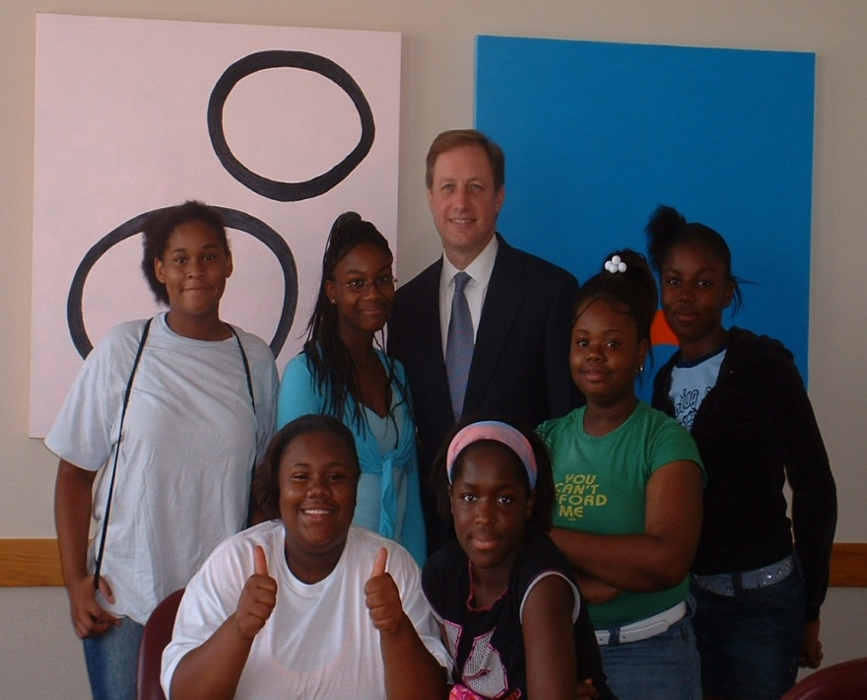
Examples – Traditional Teen Services
Homework help
Book clubs
Afterschool programming
Craft (DIY) programs
Teen Advisory Boards

Slide 10
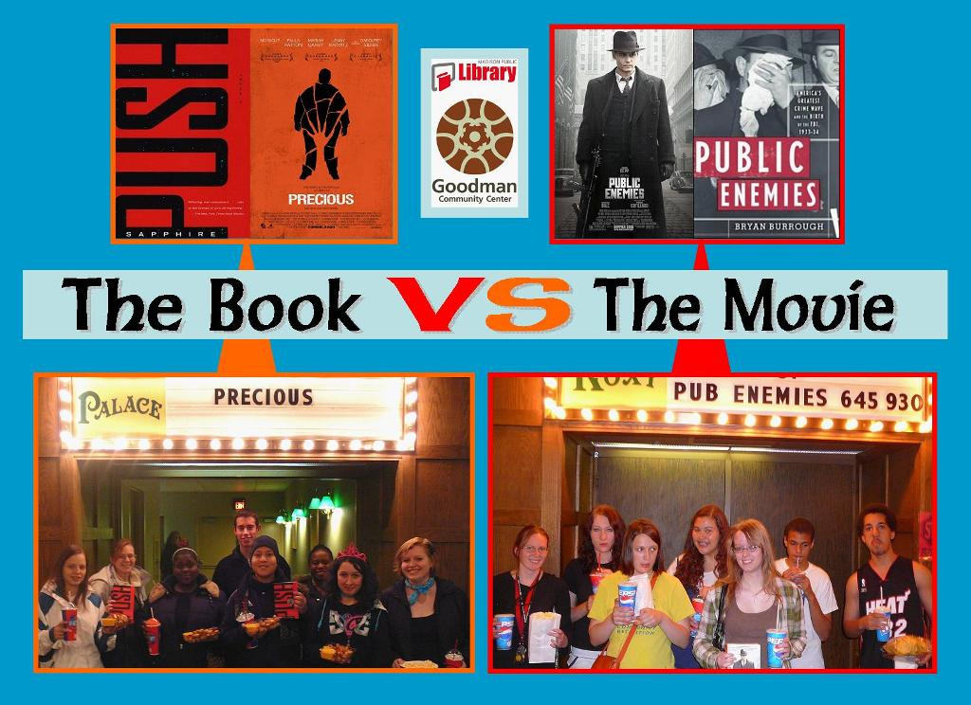
Examples – New Services
Gaming programs
Performance space
Film series
Opportunities for community engagement
Job seeking assistance
Help for teen parents
Outreach to juvenile detention centers

Slide 11
Paying for it
Library Services and Technology Act Funds
Nearly $300,000 since 2001
Literacy category (for early, family, adult literacy projects)
Primary purposes:
  Targeting library services to individuals of diverse geographic, cultural, and socioeconomic backgrounds, to individuals with disabilities, and to individuals with limited functional literacy or information skills
  Targeting library and information services to persons having difficulty using a library and to underserved urban and rural communities, including children (from birth through age 17) from families with incomes below the poverty line.

Slide 12
Future Projects
Early Literacy
  Creating Early Learning Environments
  Math and science
  Outreach – parent workshops
Teen Services
  Addressing needs of “tweens” in the library
  Serving 1st generation college students
  Serving needs of older teens
  Serving at-risk teens

Slide 13
Contact Information
Shawn Brommer
Youth Services & Outreach Coordinator
sbrommer@scls.lib.wi.us
608-246-7974

